Slide 1
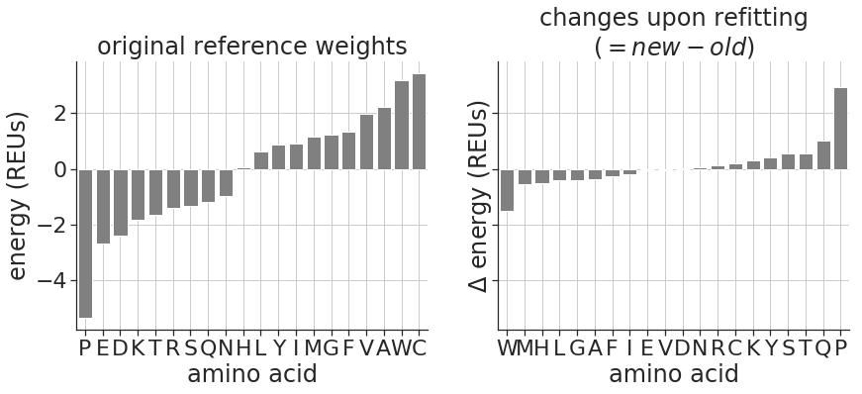
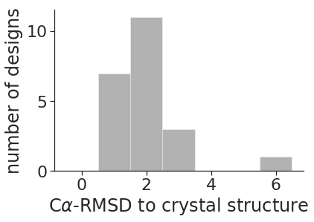
To do:
Add a figure that shows which features are most important based on ML models.
Add RMSDs for binder monomers
A
B
stability data used to fit reference weights? | native sequence recovery (one at a time) | native sequence recovery (fixbb set 2) | predicting miniprotein stability data | predicting amino-acid mutations
no | 0.297 | 44.9% | 0.50 | 0.74
yes | 0.295 | 45.7% | 0.58 | 0.74

Slide 2
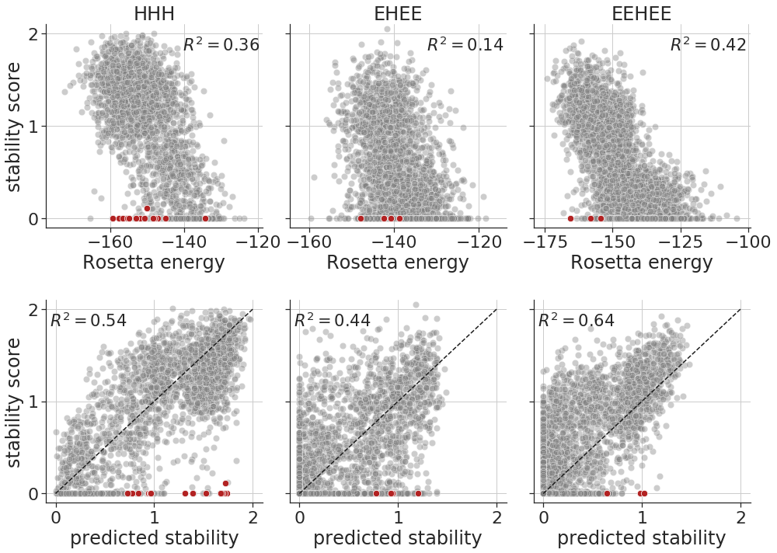
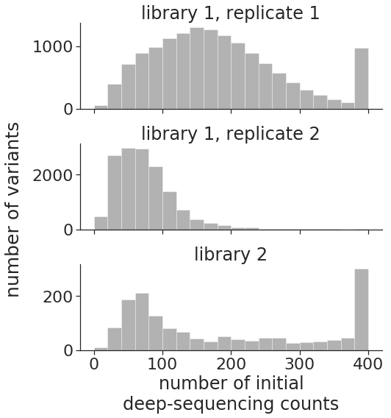
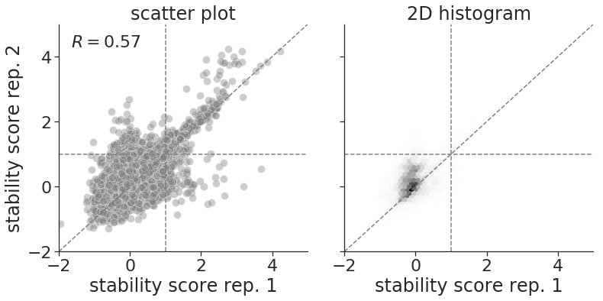
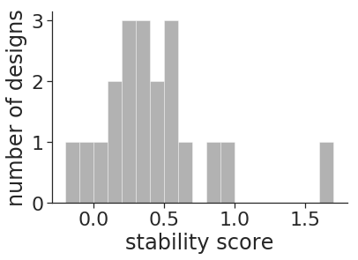
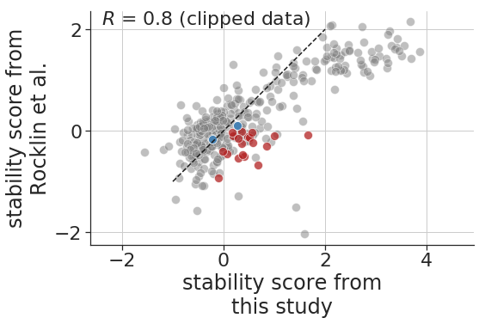
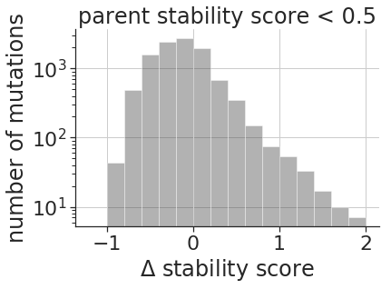
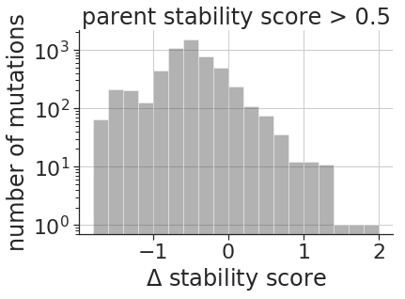
A
B
≥
C
D
E
F
G
rescue mutations
(~1%)
rescue mutations
(~1%)

Slide 3
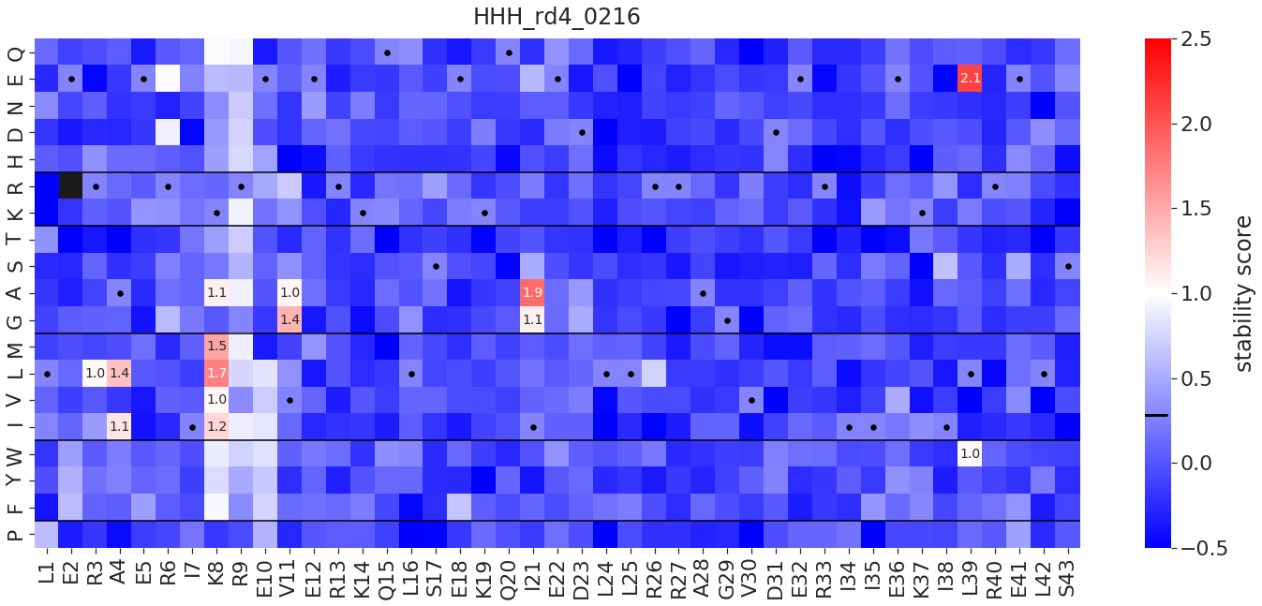
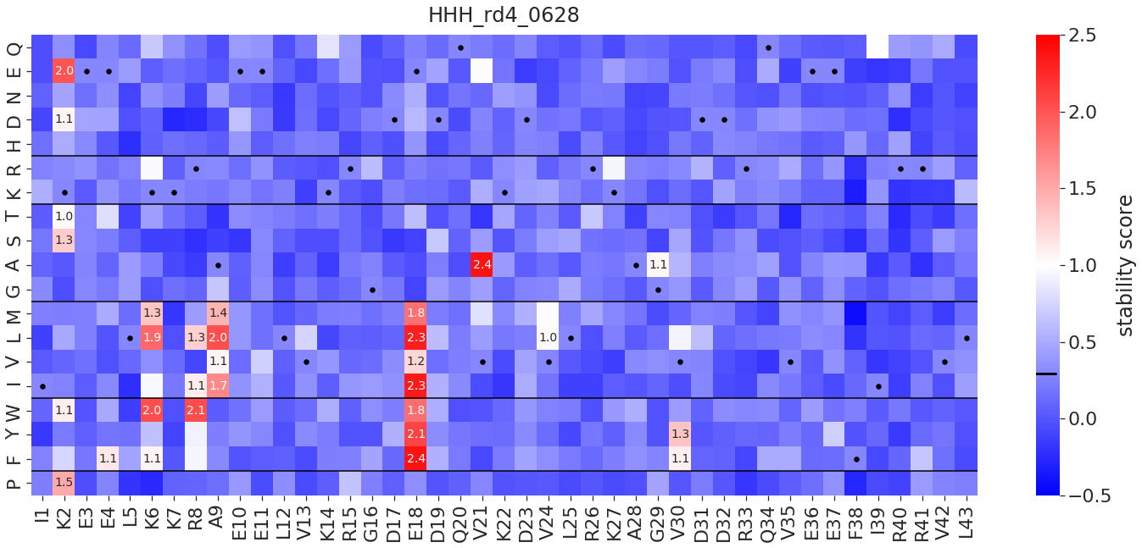
A
B
Notes:
To do:
* in B, draw a schematic of the DMS experiment showing WT gene, mutant genes, and stable/unfolded proteins
in E, replace with sticks that show distances between atoms
in F, have plots for H-C, C-C, and H-H

Slide 4
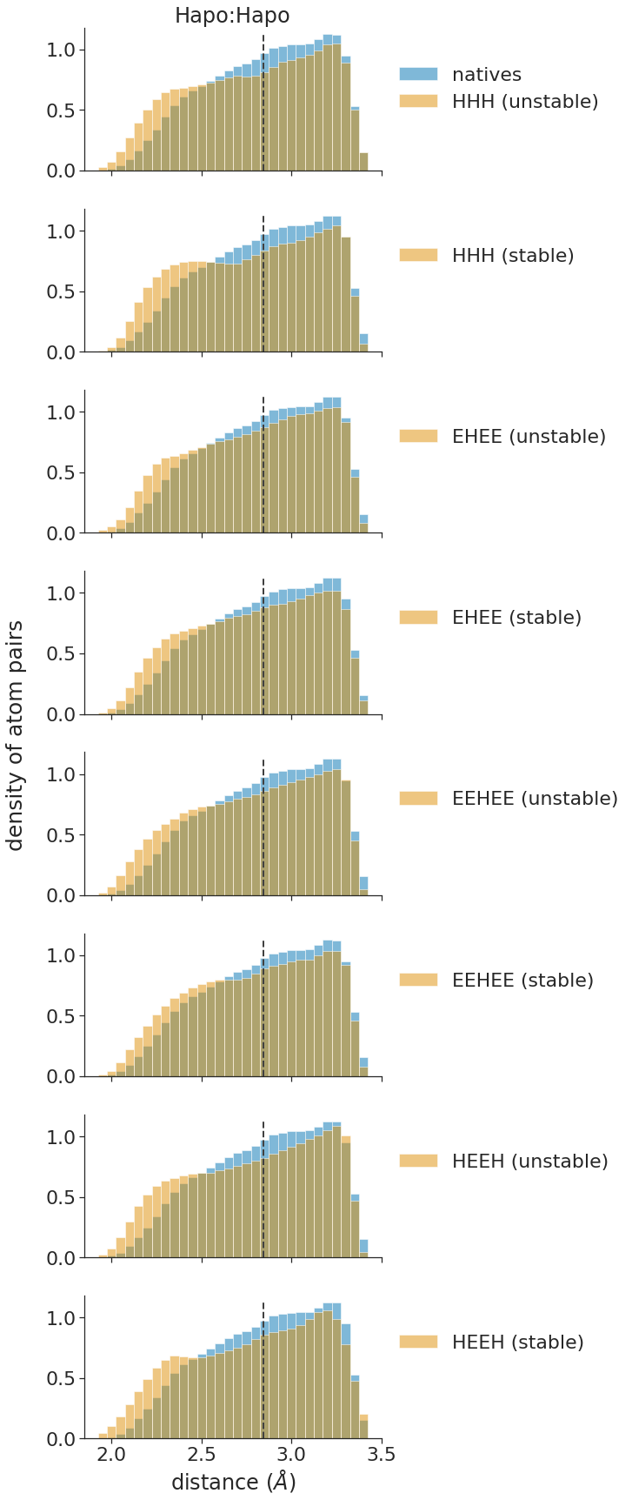
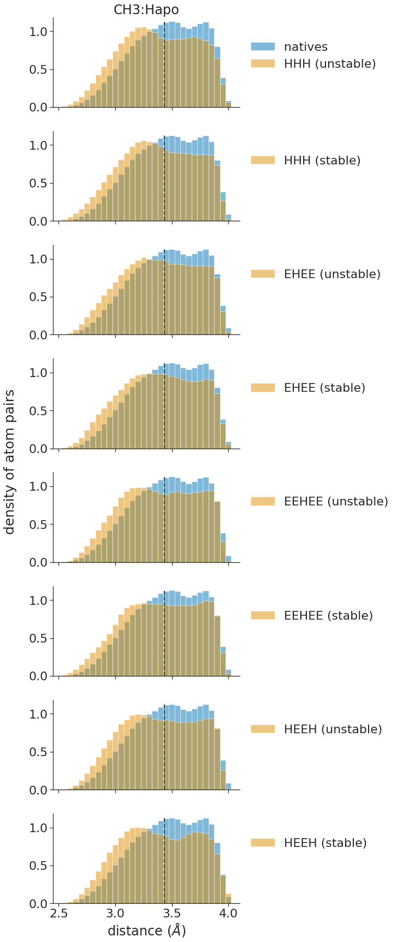
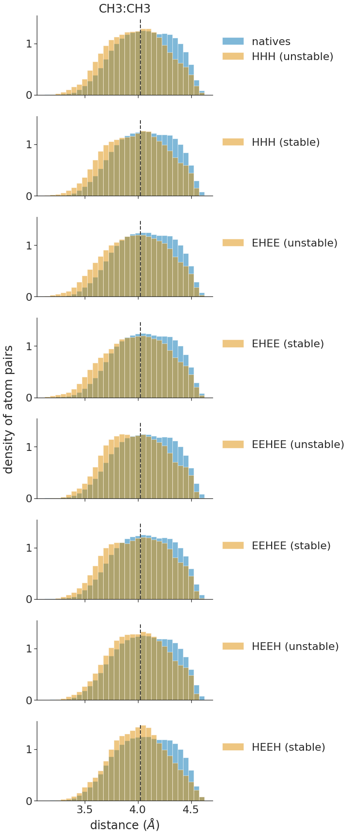

Slide 5
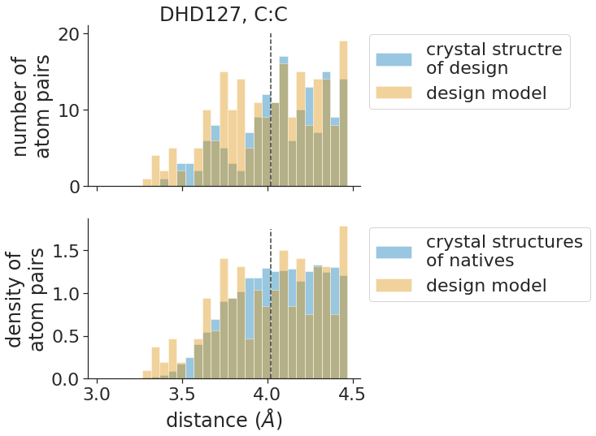
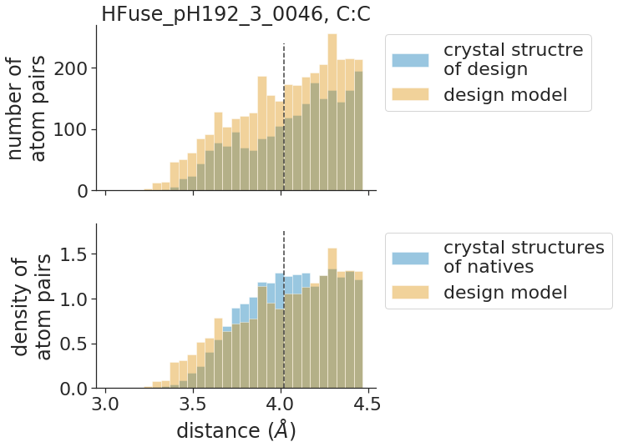
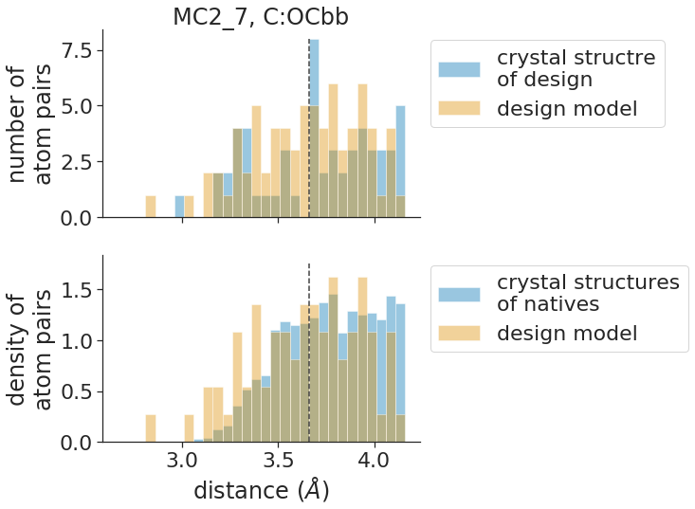
To do:
A
DHD127
crystal structure of design
design model
B
Hfuse_pH192_3_0046
crystal structure of design (blue)
design model (orange and grey)
C
MC2_7
crystal structure of design
design model

Slide 6
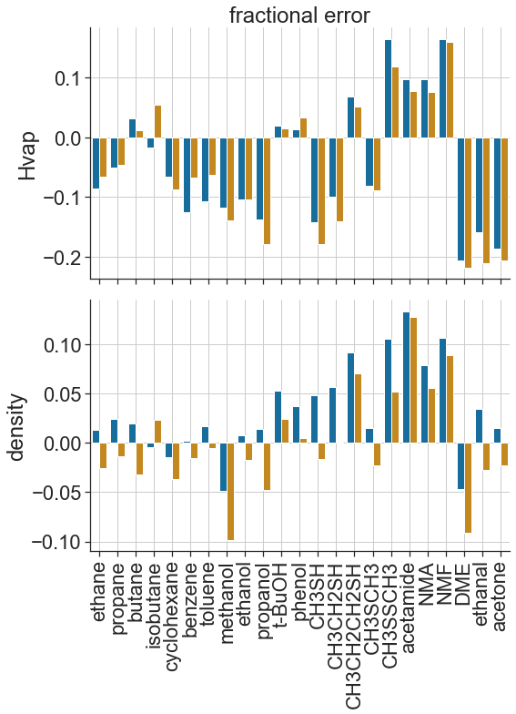
A
B
 | average fractional error
energy function | Hvap | density
beta_nov16 | 0.10 | 0.04
beta_jan22 | 0.10 | 0.04
beta_nov16
beta_jan22

Slide 8
beta_nov16
beta_jan22
beta_jan22_dd_sol
beta_jan22_dd_sol_elec
fastest
standard functional form
default “-beta” energy function
best scoring
solvation terms are depth dependent
slowest
solvation, electrostatics, and H-bond terms are depth dependent
Figure. Summary of new energy functions
report run times
try to get away with just presenting two
Notes:
To do:
too much text?
get rid of panel B?

Slide 9
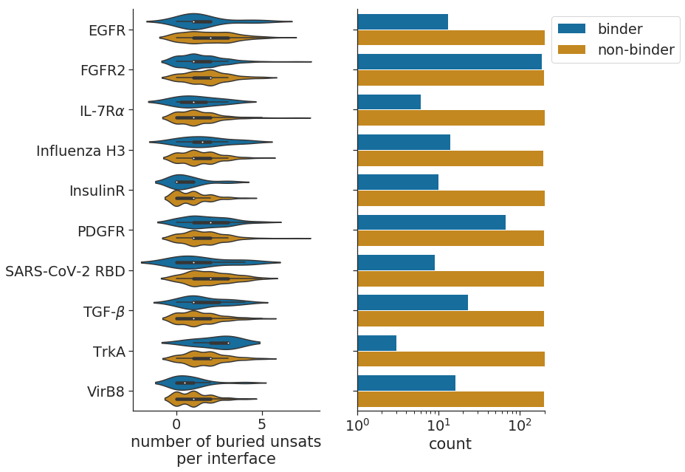
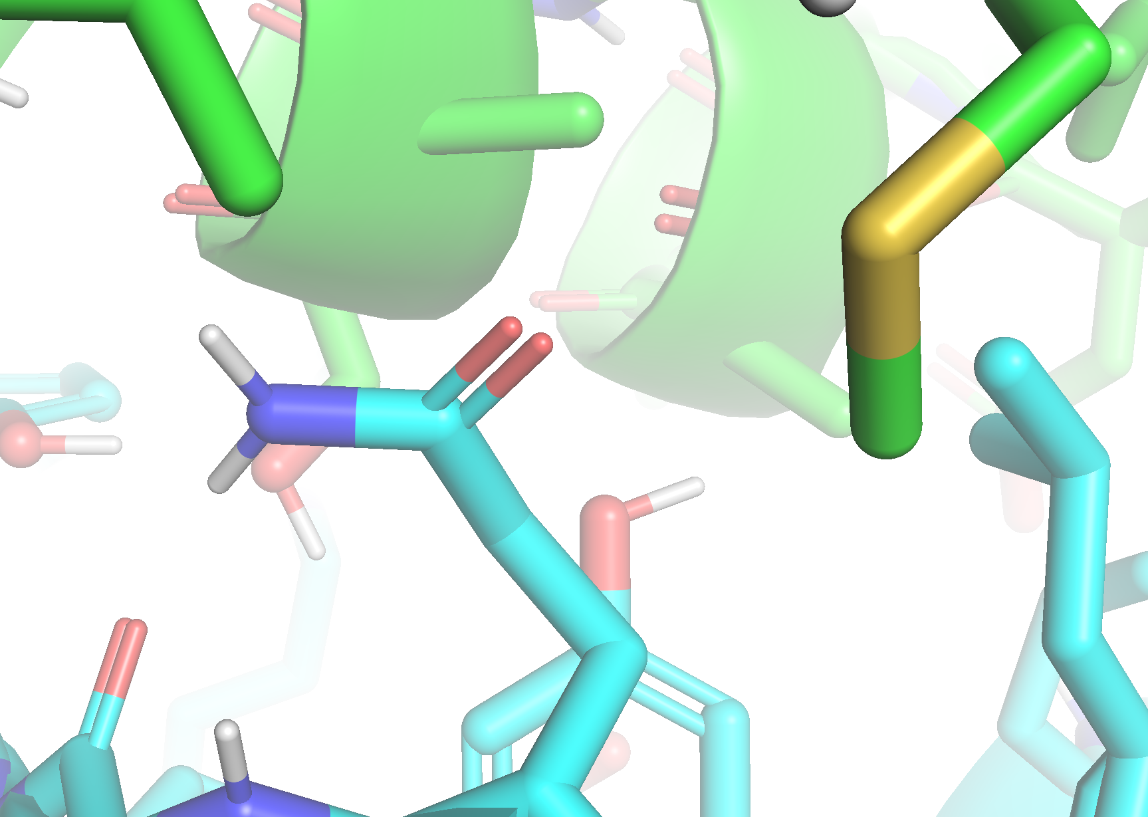
A
B
*
*
p = 0.05
*
binder design
SARS-CoV-2 RBD target

Slide 10
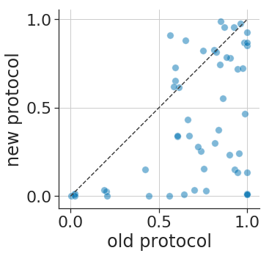
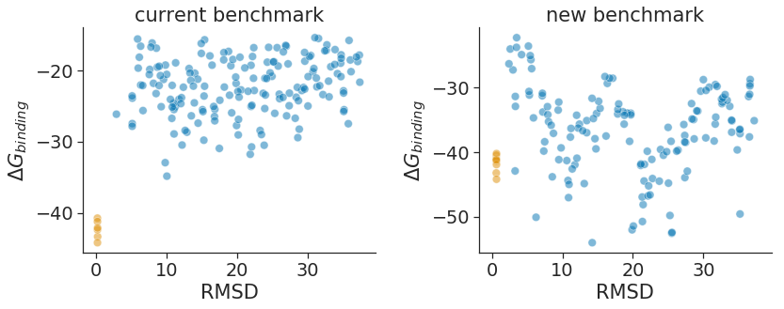
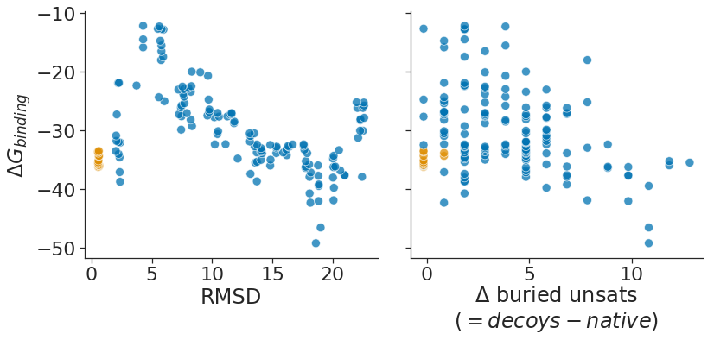
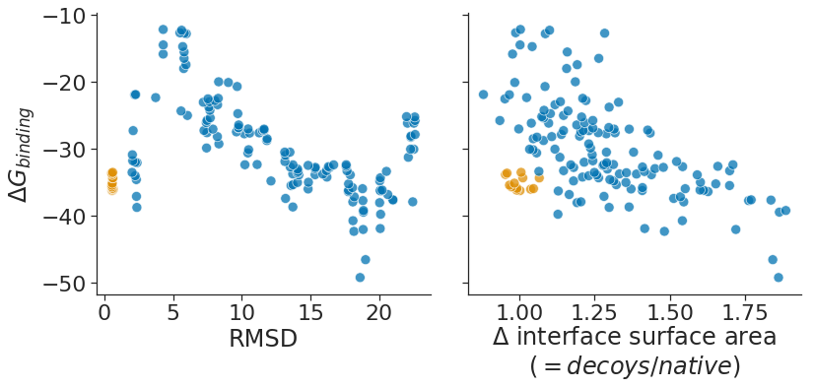
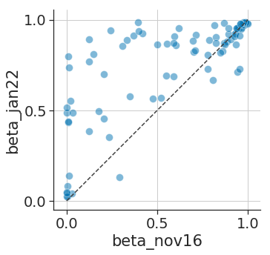
To do:
Quantify number of buried unsats in design models and compare to number in crystal structures
A
B
2AJF
2AJF
C
1KAC
D
training data

Slide 11
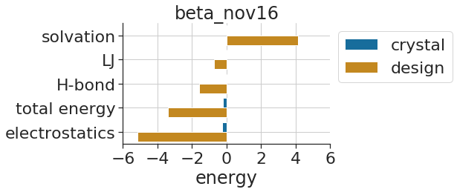
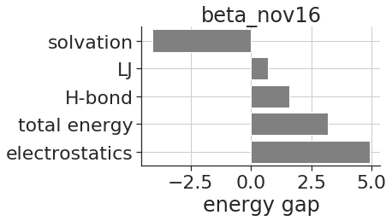
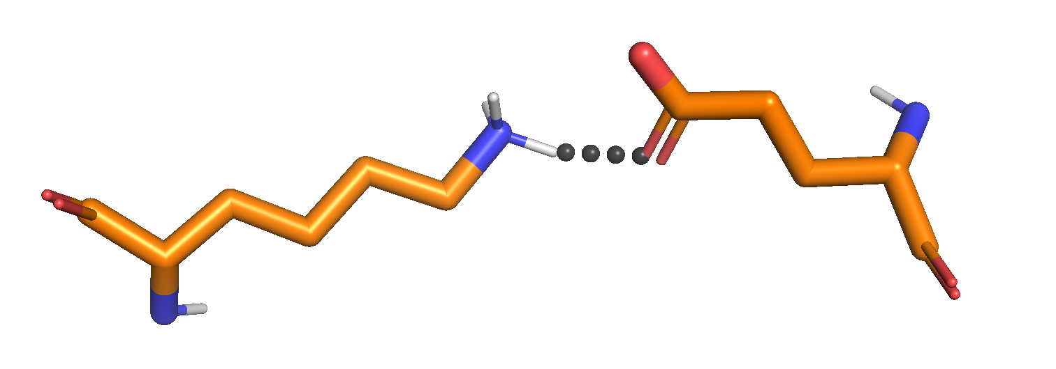
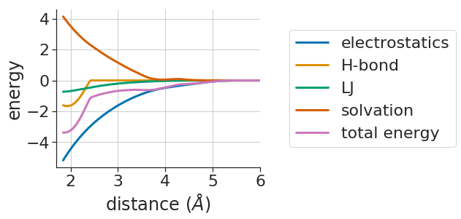
To do:
Add other examples of broken polar interactions
Show bar chart with both design energy and crystal energy broken down by score term.
Add figure showing distribution of energy gaps for beta_nov16
Add figure that compares energy gaps between beta_nov16 and beta_jan22
Add figure showing gaps computed from poly-gly backbones
A
B
d

Slide 12
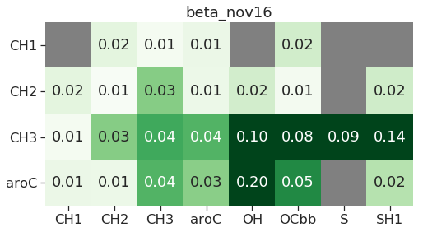
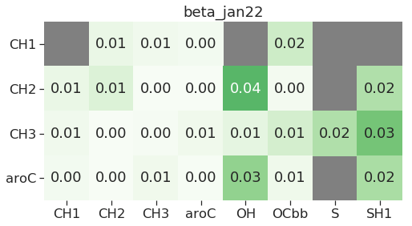
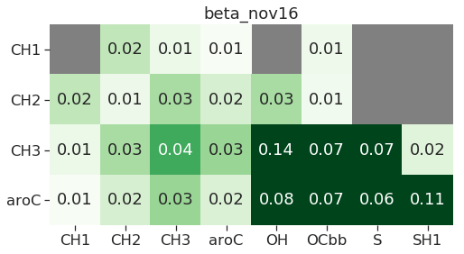
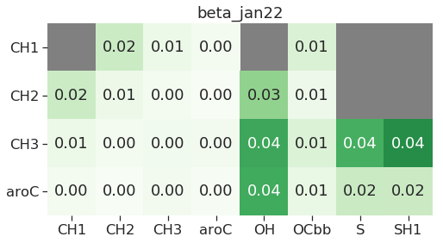
To do:
A
training data
B
validation data

